Slide 1
CSNE BCI Test Bed Design
Peter Xu
Yeongjee Chung

Slide 2
Brain Computer Interface
Three Phases
Phase 1 : External EEG and EMG measurements Off the shelf hardware, low power Bluetooth , 16 channels, Target board size 3 cm by 2 cm for 16 channel.
Phase 2: (Implantable) Integrate the front end IA with the sensor array. Consider IR as an alternative communication mechanism to carry signals out of body.

Slide 3
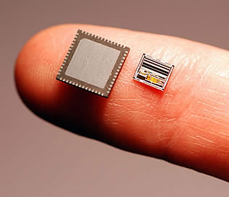
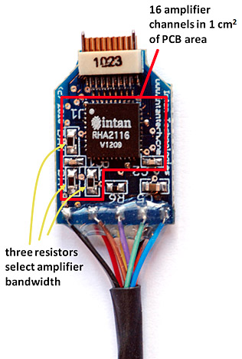
RHD2000 Features
Fully Integrated Electrophysiology front end chip
16-bit ADC
30 kSamples/s/channel
32 or 16 channel input
16 channel differential input
SPI interface with microcontroller
Low input-referred noise: 2.4 uV
DSP to filter out DC noise
Adjustable lower and upper cutoff frequency
Each amplifier on/off controllable
Each amplifier consumes: 7.6uA/kHz
Based on upper cutoff frequency
Electrical Characteristic
VDD = 3.3v
Baseline Amplifier current = 200 uA
Amplifier current = 7.6uA/kHz
Baseline ADC current = 510uA
ADC current = 2.14uA/(kS/s)
SPI current = 40 uA

Slide 4
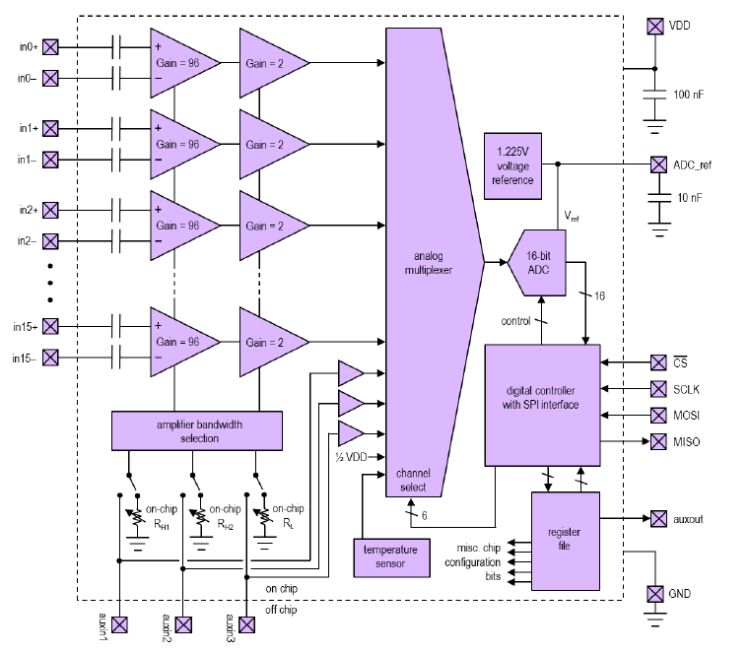
RHD2216 Block Diagram

Slide 5
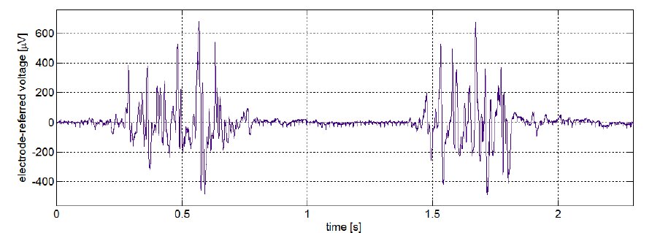
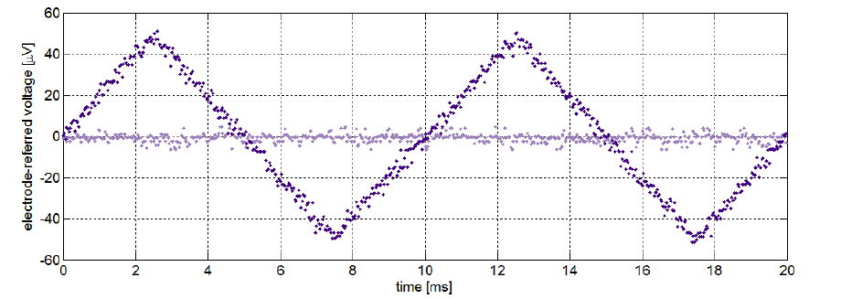
RHD2000 Characteristic
Notes:
TOP : EMG signal recorded with RHD2216 using three Ag/AgCl electrodes during bicep contractions (in0+ and in0– on bicep, 5 cm apart; ground on elbow). Amplifier was configured with fL = 2.0 Hz, fH = 1.0 kHz, and DSP high-pass filter set to 10 Hz. ADC sampling rate was 4 kS/s per channel

Slide 6
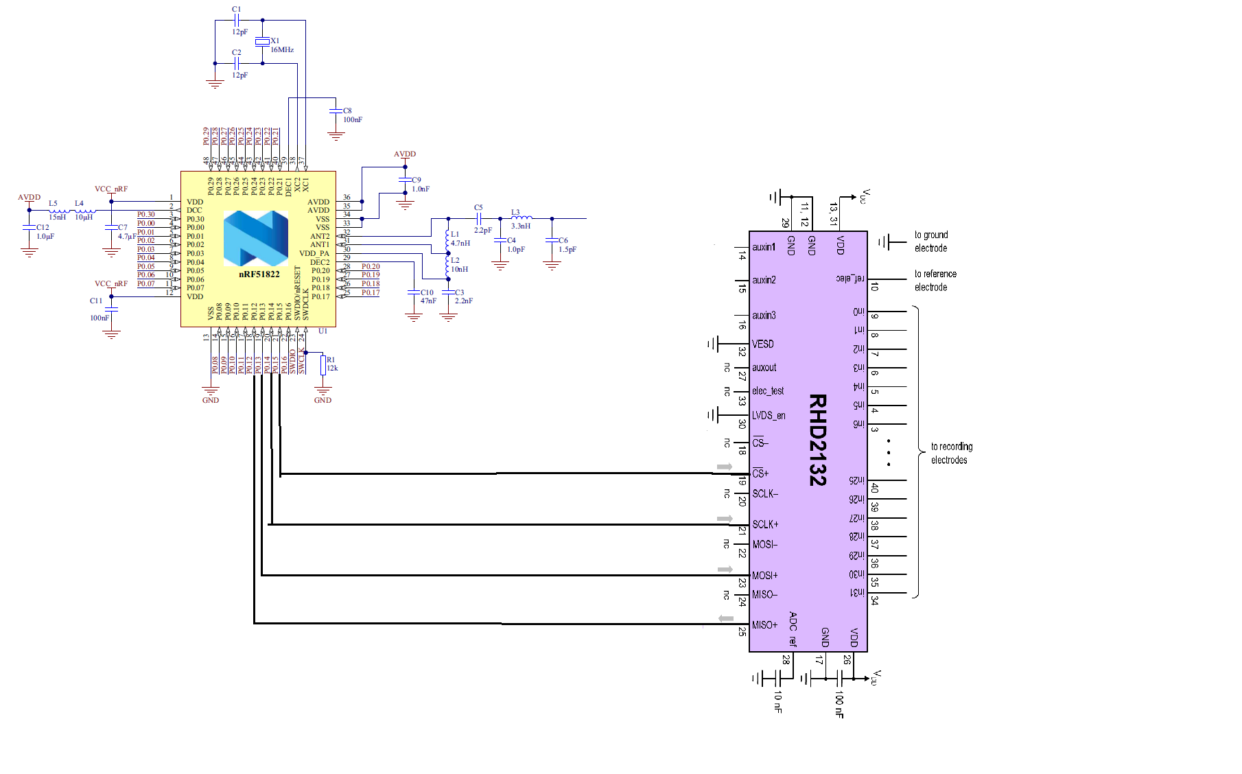
RHD2000 Interface with nRF51822

Slide 7
nRF51822 Features
32-bit ARM Cortex M0 processor
256kB flash/ 16 kB RAM
31 GPIO pins
2 SPI channels
2.4 GHz radio
Programmable output power +4dBm to -20dBm
Tx and Rx radio can be enable separately
16 MHz oscillator
GFSK Modulation
2 Mbps maximum On-air data rate
-85dBm at 2 Mbps sensitivity
Selectable peripheral module On/OFF
2 uA when all peripherals in IDLE and CPU OFF

Slide 8
nRF51822 Characteristic
Electrical Characteristic (Processor)
VDD = 3.0v
I @ 16MHZ running off flash memory = 4.4 mA
Electrical Characteristic (Radio 2.4 ghz)
VDD = 3.0v
Tx Current @ +4dbm = 16 mA
Tx Current @ -16dbm = 6 mA
Rx Current @ 1 mbps = 13 mA
Electrical Characteristic (SPI)
VDD = 3.0v
Current @ 125kbps = 180 uA
Current @ 8 Mbps = 200 uA
Mechanical Characteristic
L x W x H = 6 x 6 x .85 (mm)

Slide 9
Test Bed System
Block Diagram(Closed Loop Control)
Sensory Front-End
Pre-Filter
Amp
Post-Filter
A/D
I/O
Wireless RF
Wireless RF
Wireless Optic
Wireless Optic
Control Logic for Encoding
Signal Processing
Actuator Front-End
Controller
D/A
I/O
External
Actuator
Robotics
Bio-Signal I/F
Wireless I/F
Sensory/Actuator I/F
Control I/F

Slide 10
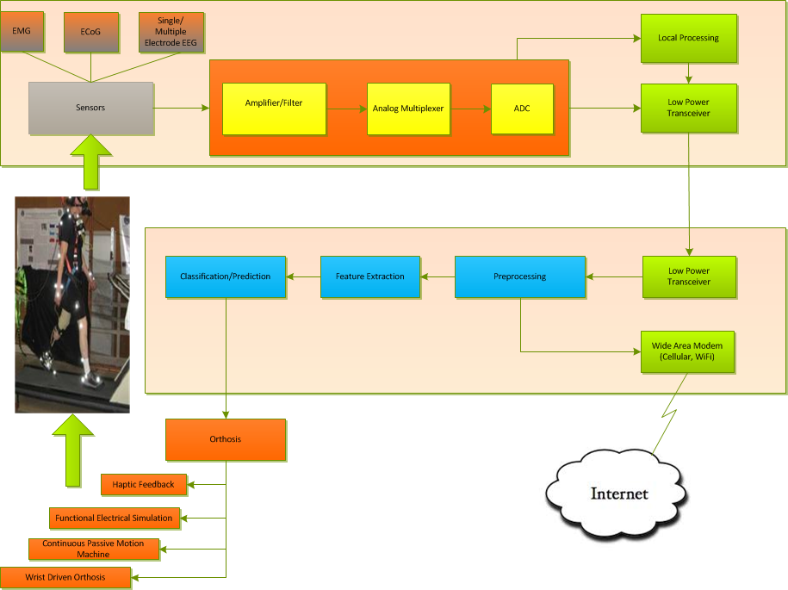

Slide 11
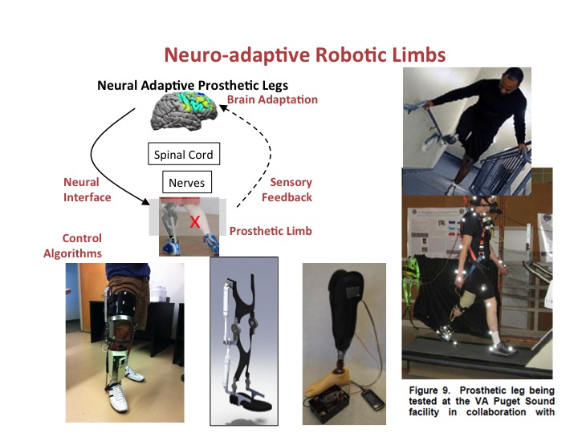
Modular Building Block Structure
Brain/Body
Wearable BCI
External Device
ECoG
Multi-Ch.
ZigBee
Comm.
Module
EMG
VCSEL
Comm.
Module
EEG
Analog Process Module
A/D
DSP Module
BlueTooth
Comm.
Module
Control Module
Wireless I/F
BioSignal I/F
BioData I/F
DSP
Module
Haptic Feedback
Functional Stimulator
Feature Extraction
Passive Motion Machine
Prediction
Wrist Driven Orthosis
Prosthetic Devices

Slide 12
Modular Software Building Block
Brain/Body
Wearable BCI
External Device
Sensory Module
Analog Process Module
A/D
DSP Module
Comm.
Module
Comm.
Module
DSP
Module
Control Module
BioSignal I/F
BioData I/F
Wireless I/F
External Device
Driving
Module
Application
Command API
Command API
Command/Response
Command API
Command API
Command API
Command API
Event/Drive
Event/Drive
Event/Drive
Event/Drive

Slide 13
Command/Response API
Filter
Turn ON/OFF
Power Level Setting
Signal Threshold Setting
Timing
DSP Function
Data Encoding
Module Type
….

Slide 14
Functioning Blocks
Sensory Signal Det.
Encoding
Decoding &
Signal Processing
Controlling Ext. Devices
Instrument Amp.
A/D
Wireless Mod.
Wireless Demod.

Slide 15
Sensory Signal Detect
EEG
EMG
Sensing
Pre-Processing
ECoG
Implantable-Electrode Array Bio-Patch Array Bio-Sensor Array
(EEG, EMG, ECoG)
Contact -Conductance Control
Noise,
CrossTalk,
Low-signal,
Sensing Array

Slide 16
Pre-Processing and Amplification
Pre-Processing
Balanced Pre-Amplification
Analog Filter w/ Low-signal
Matching Circuitry
Multi-Channel Input
Low-Noise Inst. Amp.
Balanced Differential Amp.
Open-Ground
No Temperature Rise
Multiplexing
Refine Signal Amplified
Noise Reduction

Slide 17
A/D Conversion
Post-Processing
A/D Conversion
External Transmission
Signal-Level Prediction
Sampling/Data Rate
Digital Control
Digital Data Rate
Encoding
Digital Interface
VCSEL
SPI

Slide 18
External Control
External Receiving
Controller
Wireless Transmission
Blurtooth BLE
ZigBee
Optical Coupling (VCSEL/Photo Cell)
Decoding
Signal Processing(DSP)
Pattern Prediction
SmartPhone Application
(Bluetooth)
Decision for Analysis/Actuator
Pattern Monitoring
Actuator/ Robotics Control

Slide 19
External Control
Monitoring
Actuator
Robotics
Smart Phone Application
(Wireless Internet)
External Device Control

Slide 20
Break-down of considerations Sensory front-end
Sensor type
Implantable Electrode(ECog)
External bio-patch(EMG, EEG)
Number of sensors in array for multi-channel processing and multiplexing
Ground type
Open ground or Common ground
Balanced input or Single input

Slide 21
Break-down of considerations Sensing & Pre-Processing
Signal volatage level targeted
10uV ~ 300uV
Noise level allowed for LNA
Channel separation by filter
Matching circuitry for ohmic contact to skin or brain (contact conductance control)
Cabling type for mechanical connecting
Flexible cables, Hard wires or Bare Wires
Connecting Methods

Slide 22
Break-down of considerations Pre-Amplification
Chip-set for low noise instrument amp.
Analog Device, Burr Brown
Intan (Integrated one of DSP)
Balanced input or single input
Ground type
# of channels
Power supplying
Low temperature rise when applying inst.amp.
Multiplexing the amplified outputs
Noise reduction by filter

Slide 23
Break-down of considerations A/D Conversion
Input signal level prediction 1~100mV
Powe Budget Analysis
Sampling rate and data rate
Chip set of A/D Convter
A/D Conversion control circuitry
Power supplying
# of channels A/D conversion
Digital control logic

Slide 24
Break-down of considerations A/D Conversion(cont.)
Digital control logic for transmit control
Digital data rate
Encoding methods of digital output from A/D
Digital interface
VCSEL : IR/PhotoCell
SPI

Slide 25
Break-down of considerations External Transmission
Wireless Transmission
Bluetooth Low Energy
ZigBee
Optical Coupling
VCSEL/PhotoCell
Power supplying Options
Wireless charging circuitry + Small Battery
Wireless power supplying

Slide 26
Break-down of considerations External Controller
Digital decoding
Digital signal processing
Pattern prediction
Controller applications in PC
Controller applications in SmartPhone
Directly applied to SmartPhone by Bluetooth
Analysis programming
Monitoring
External Actuator/Robotics control

Slide 27
Interface Issues
Characterize each interface for implementation
Availability for the tune-up of interface specifications with various implementations by 3rd party
Power budget analysis required at each interface
Low power consumption design required
Bluetooth L.E.
VCSEL Array (Vertical Cavity Surface Emitting Laser)

Slide 28
Considerations for BCI
3 Phases Approach
1st Phase
Feasibility for applicability to BCI
Intan off-shelf chip set + Nordic BLE chip set
2nd Phase
Miniaturizing the size and Form factor
Power supply issue: Wireless power or Battery

Slide 29
3rd Phase
Mount Die-Chips on Flexible PCB
Integrate analog parts with electrodes in front sensor end
Integrate digital parts with wireless antenna
SOC

Slide 30
1st Phase Considerations
Intan chip(RHD2232) + Nordic BLE chip(nRF51822) by off-the-shelf products
Miniaturized precision connector or direct cabling linked to bio-patches for collecting bio-signals
Chip-antenna of 2.4GHz for Nordic BLE nRF51822
Polymer lithium battery for power supply with flexibility

Slide 31
1st Phase Considerations
Power budget analysis at each stage
Power supply alternative options with wireless power supply by induction coil printed in PCB
Temperature rise by induction coil (~2°K)
Microwave activity influence in brain
Flexible PCB applicability

Slide 32
Implementation Issues
Implementation Issues
Bluetooth L.E.
Bio-Patch
Intan RHD2232
nRF51822
nRF51822
Sensory Front-End
Pre-Filter
Amp
Post-Filter
A/D
D/A
I/O
Wireless RF
Wireless RF
Wireless Optic
Wireless Optic
VCSEL
VCSEL
Laser Optics
Sensory Front-End
Filter BW Cont., Optic Encoding
Power Supply Circuitry
Sensor Array
Polymer-Ion
Battery
Wireless Charging Circuitry
Signal Processing
Smart-Phone
PC
20mm X 15(<20)mm

Slide 33
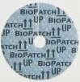
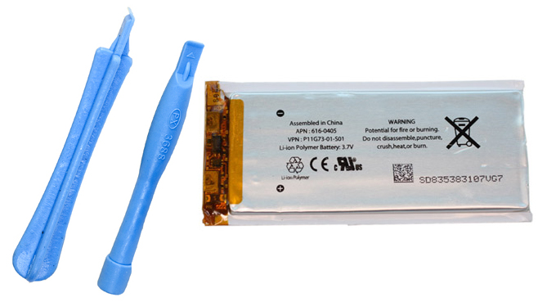

Implementation
30mm
10mm
nRF
51822
Antenna
10mm
Intan
RHD
2232
SPI
Digital & Wireless
(Bluetooth L.E.)
Bio-Patch
Analog Part

